Slide 1
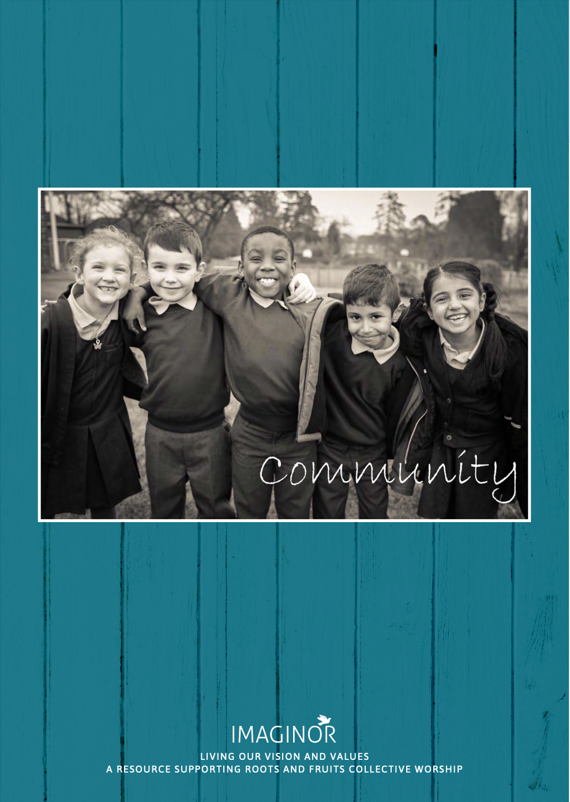


LIVING OUR VISION AND VALUES
COMMUNITY
LIVING IN HARMONY
1
LOOK
Take a few moments to look carefully at this photograph.
If you were to choose one word to sum up the image, what would it be?

Slide 2

LIVING OUR VISION AND VALUES
COMMUNITY
LIVING IN HARMONY
1
LEARN
Wise Words
Clothe yourselves with love which binds us together in perfect harmony.
Colossians 3:14 (paraphrase)
What does it mean to live in harmony in a community?
If we are living in harmony with one another, what will visitors to our school see?
What will they hear?
What will they feel?

Slide 3

LIVING OUR VISION AND VALUES
COMMUNITY
LIVING IN HARMONY
1
REFLECT
What kinds of behaviour can break the bonds of harmony (stop people getting on together) in our school community?
What can we do to restore (bring back) harmony
when things go wrong?

Slide 4

LIVING OUR VISION AND VALUES
COMMUNITY
LIVING IN HARMONY
1
1
PRAY
Lord Jesus Christ,
Thank you for our school community.
Help us to live together in a way that makes everyone feel valued, precious and loved.
Amen

Slide 5

LIVING OUR VISION AND VALUES
COMMUNITY
LIVING IN HARMONY
1
1
LIVING IT OUT
How does working together in harmony help
us to live out our school vision?

